Slide 1

Cairo University
Faculty of Engineering year
Dept. of Electronics and Communications
ELC 3030
EECE – 1nd
Advanced Microprocessor Architecture
UART & USB Emulator project
Team: 36
Name | Section | B N
Ali Badry | 3 | 4
Hassan sayed hassan | 2 | 5
Doaa Mohamed shafiy | 2 | 13

Slide 2
UART PART
data Bits | stop bits=1 |  |  | stop bits=2
 | no Parity | even Parity | odd Parity | no Parity | even Parity | odd Parity
7 bits | 22.22% | 30% | 30% | 30% | 36.36% | 36.36%
8 bits | 20% | 27.27% | 27.27% | 27.27% | 33.33% | 33.33%
Table1.1_UART percentage Overhead results
From the result above , We found that if we increase the number of stop bits to two bits or adding parity bit for error detection or using 7 bits data rather than 8 bits (as many pure data decrease overhead),the Overhead on system increases ,and vise versa
data Bits | stop bits=1 |  |  | stop bits=2
 | no Parity | even Parity | odd Parity | no Parity | even Parity | odd Parity
7 bits | 77.78% | 70% | 70% | 70% | 63.64% | 63.64%
8 bits | 80% | 72.73% | 72.73% | 72.73% | 66.67 | 66.67%
Table1.2_UART Efficiency results
From the result above , we found that if we increase the number of stop bits to two bits or adding parity bit for error detection or using 7 bits data rather than 8 bits (as many pure data increase efficiency ),the Efficiency on system decreases ,and vise versa, and also that make sense as Efficiency is opposite to Overhead
data Bits | stop bits=1 |  |  | stop bits=2
 | no Parity | even Parity | odd Parity | no Parity | even Parity | odd Parity
7 bits | 1.152sec | 1.28sec | 1.28sec | 1.28sec | 1.408sec | 1.408sec
8 bits | 1.28sec | 1.408sec | 1.408sec | 1.408sec | 1.536sec | 1.536sec
Table1.3_UART Time Total results
From the result above ,we found that if we increase any bits over the lowest minimum number of required bits, total time of transmitting increases , regardless the bits type that’s from make sense.

Slide 3
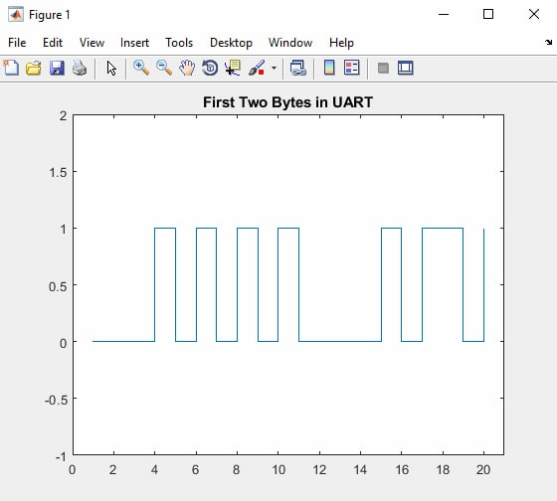
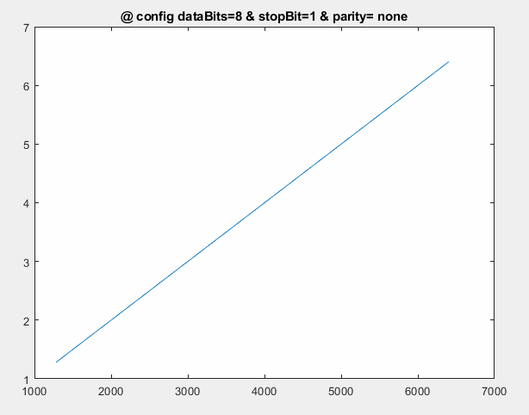
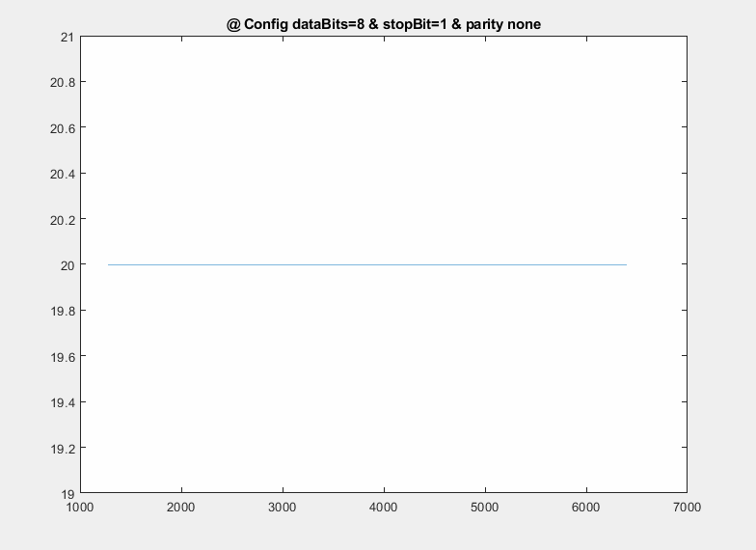
First two bytes in UART result , which have 1 start Bit , 8 bit Data , no Parity , 1 stop Bit
The First two character in input file is Th which has a binary data 0001010101 and 0000101101 Respectively
Figure1.1_UART First two bytes
Figure1.2_UART Transmitting Time
Figure1.3_UART Percentage Overhead

Slide 4
USB PART
Payload | Overhead
 | File size = 1280 bytes | File size = 2560 bytes | File size = 3840 bytes
128 bytes | 2.754% | 2.754% | 2.754%
90 bytes | 8.8563% | 5.7133% | 4.617%
200 bytes | 10.1991% | 3.291% | 5.709%
Table2.1_USB percentage Overhead
When we made our the file size a multiple of the payload, the overhead remained constant as all the packets will be full. Thus, the minimum overload is (without the existence of bit stuffing) is 2.754%. When the file size is not a multiple of the payload, it changes as shown in table 2.1.
Payload | Efficiency
 | File size = 1280 bytes | File size = 2560 bytes | File size = 3840 bytes
128 bytes | 97.246% | 97.246% | 97.246%
90 bytes | 91.1437% | 94.2867% | 95.383%
200 bytes | 89.8009% | 96.709% | 94.291%
Table2.2_USB percentage Efficiency
Payload | Transmission time at (0.0001 sec bit duration)
 | File size = 1280 bytes | File size = 2560 bytes | File size = 3840 bytes
128 bytes | 1.053 | 2.106 | 3.159
90 bytes | 1.1235 | 2.1721 | 3.2207
200 bytes | 1.1403 | 2.1177 | 3.258
Table2.3_USB percentage Transmission time (sec)
The Transmission time increases by increasing the file size despite the payload difference. The transmission time is linear proportional with the bit duration. The relation is also nearly linear with the file size as shown in table 2.3.

Slide 5
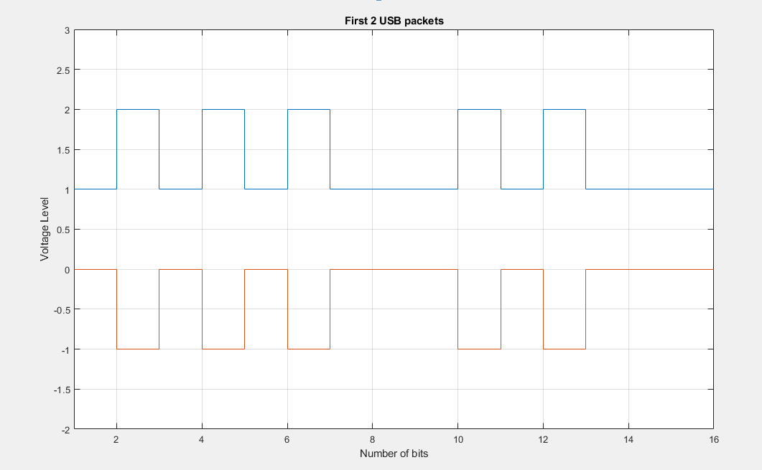
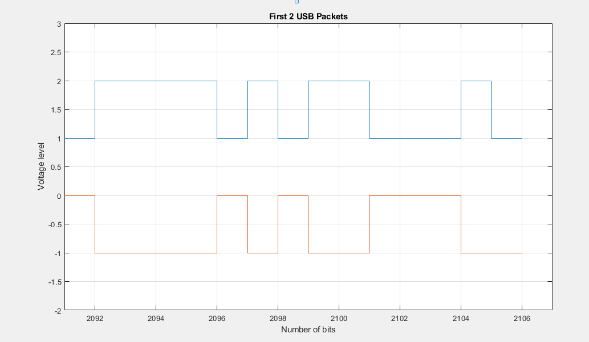
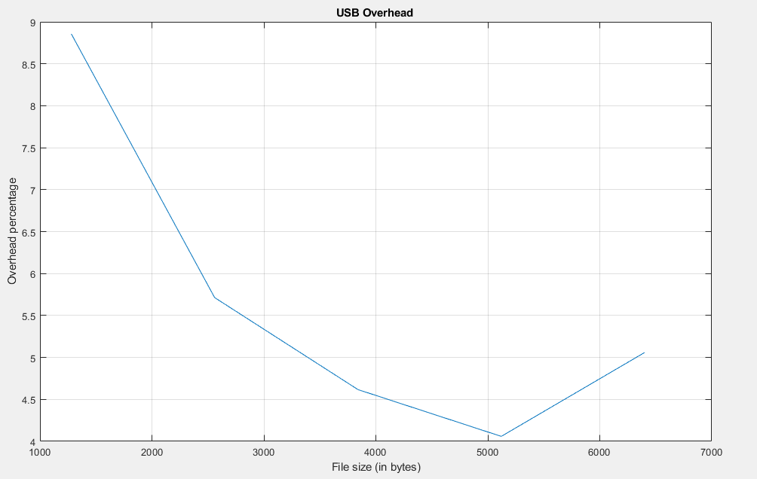
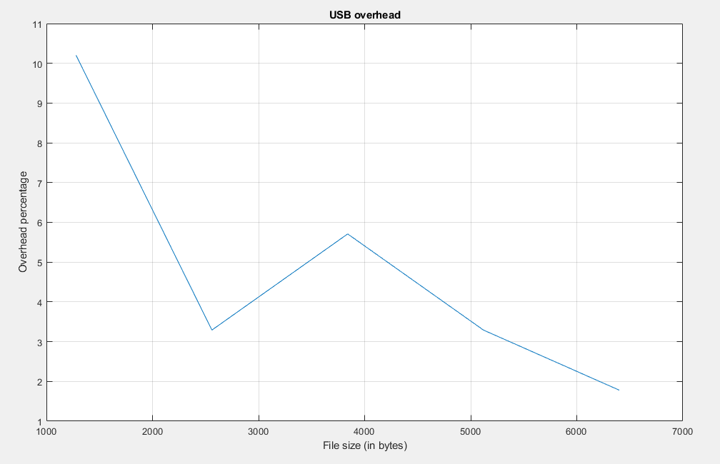
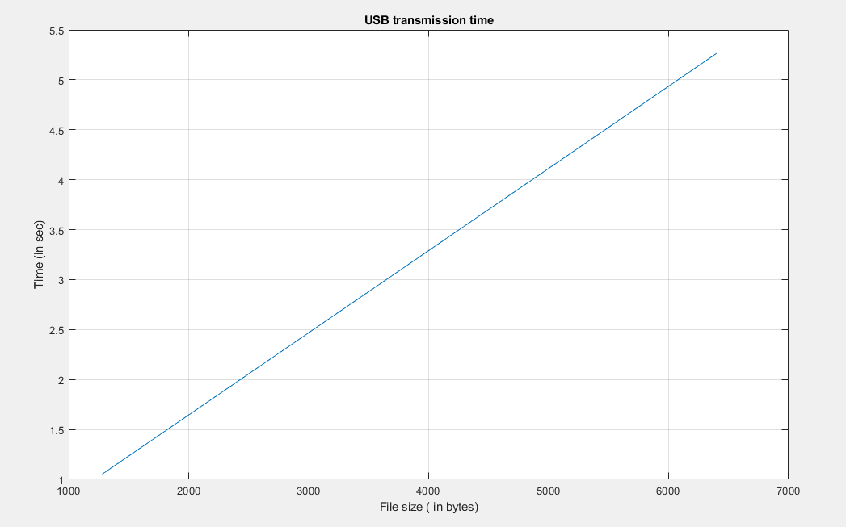
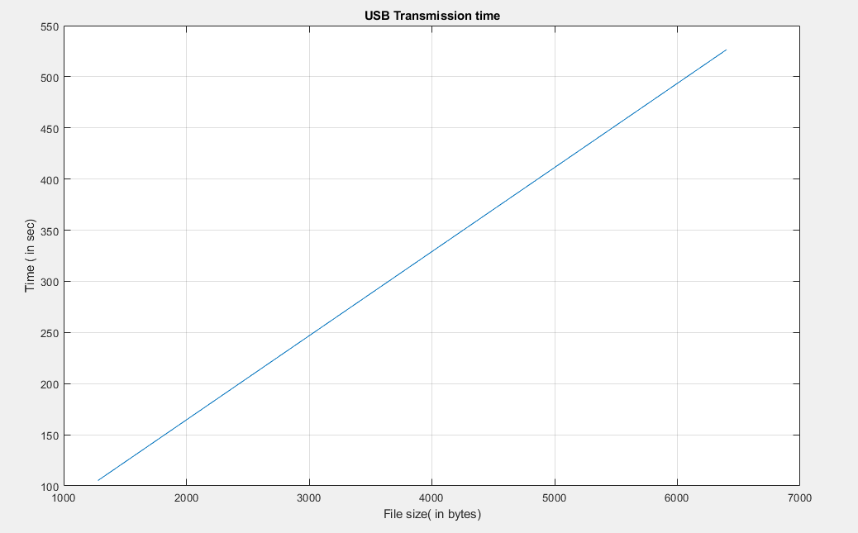
Figure2.1_USB First two bytes (First 15 bits)
Figure2.2_USB First two bytes (Last 15 bits)
Figure2.3_USB Address before bit stuffing
Figure2.4_USB Address after bit stuffing
Figure2.5_USB overhead at 90 bytes payload
Figure2.6_USB overhead at 200 bytes payload
Figure2.7_USB Transmission time at 0.1 msec/ bit
Figure2.8_USB Transmission time at 0.01 sec/ bit

Slide 8
OUTPUT PART
[{
"Protocolname":"UART",
"outputs":{
"total_tx_time":1.28,
"overhead":20,
"efficiency":80
}
},
{
"Protocolname":"USB",
"outputs":{
"total_tx_time":1.0530000000000002,
"overhead":2.7540360873694207,
"efficiency":97.245963912630586
}]

